Slide 1
THE ROLE OF PETROPERÚ IN THE HYDROCARBONS SECTOR
July 2012
Energy Day
Eng. Humberto Campodónico Sánchez
Chairman of the Board
PETROPERÚ S.A

Slide 2
PETROPERU after privatization
LOT Z2-B
LOT X
LOTS 8/8X
LOTS 31 B/D
PETROMAR
Northwest
North forest
Central forest
SERPETRO
OIL PIPELINE
TRANSOCEANIC
GAS PLANT
TALARA
LA PAMPILLA
CONCHAN
IQUITOS
EL MILAGRO
PUCALLPA
REFINERY
REFINERY
REFINERY
REFINERY
REFINERY
REFINERY
PTA. VTAS.
PTA. VTAS.
PTA. VTAS.
PTA. VTAS.
PTA. VTAS.
PTA. VTAS.
TALARA
CONCHÁN
IQUITOS
YURIMAGUAS
EL MILAGRO
PUCALLPA
PTA. VTAS.
PTA. VTAS.
PTA. VTAS.
PIURA
TARAPOTO
PUCALLPA
CALLAO
SUPE
ETEN
SALAVERRY
CHIMBOTE
PISCO
MOLLENDO
ILO
PETROPERÚ
TERM.
TERM.
TERM.
TERM.
TERM.
TERM.
TERM.
TERM.
Leased
Privatized
78 SERVICE STATIONS
SOLGAS
PETROLUBE
Disabled
Solvent plant
Fertilizer plant
Carbon black
plant

Slide 3
Participation of PETROPERÚ in the Oil Industry
EXPLORATION/ PRODUCTION
REFINING
45%*
OIL PIPELINES
COMMERCIALIZATION
47.5%**
TRANSPORT
SERVICE STATIONS
PRIVATE
* Peru has a total refining capacity of 209.8 MBPD.
** Average figure up to May 2011. The remaining 52.5% is distributed among Repsol, Maple, Camisea, importers and others.

Slide 4
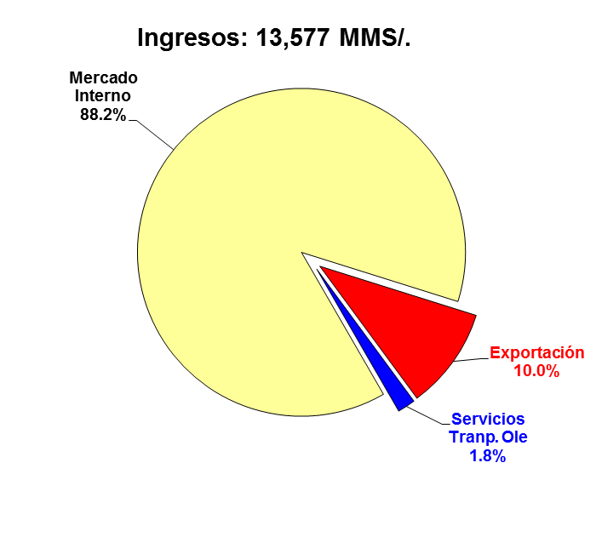
PETROPERÚ IN FIGURES 2011
INCOME AND EXPENSES
Income: S/ 13,577 MM
Internal Market
Export
Transport Serv. – Oil pipeline
(*): Includes purchases of crude oil, intermediate and derivative products.
(**): Includes Other income, other cargos, provision for and recovery of contingencies.
The operating profit in 2011 increased by 85% in relation to the previous year (S/ 722 MM vs. S/ 388 MM) due to higher sales, both in volume and in prices.
As a result of the operating profit and the company’s productivity improvements, net profit was also higher (S/ 532 MM vs S/287 MM).

Slide 5
Where we actually stay?
At present, the main companies of the region operate in an integrated way.
In other words, they have oil lots, except PETROPERÚ S.A.
Company | Country | Property | Integrated | International
ECOPETROL* | Colombia | State | YES | YES
ENAP* | Chile | State | YES | YES
PETROBRAS* | Brazil | State | YES | YES
PEMEX | Mexico | State | YES | YES
PDVSA | Venezuela | State | YES | YES
PETROECUADOR | Ecuador | State | YES | NOT
PETROPERÚ | Peru | State | NOT | NOT
(*): They operate in Peru.

Slide 6
National oil companies (NOCs) in Perú
Exploration and Production
ECOPETROL from Colombia and KNOC from South Korea in SAVIA.
China National Petroleum Corporation (CNPC) in SAPET
CNPC in Pluspetrol Norte on Lot 8, where share ownership of Lot with KNOC from South Korea and with the Pluspetrol private Company from Argentina.
SONATRACH from Algeria in Camisea Consortium
PETROBRAS on Lot X (100%), Lot 58 (100%) and Lot 57 (43%, the remaining 57% is from Repsol)
Commercialization
ENAP (49%) in PRIMAX in partnership with Romero Group.
Power transmission
ISA from Colombia in power transmission grids.

Slide 7
New legal framework PETROPERÚ S.A.
  Law to Strength and modernize PETROPERÚ
  Law No. 28840 (2006) the objective is to conduct activities in the entire chain. Pending regulation.
  Corporate strategy plan 2011-2025.
  To keep updated the new rules and the technical mandate. Approved by Ministry of Energy and Mines through MR 191 – 2011 – MEM/DM.
  Good coordination with Government and Companies
  S.D. 001-2012 – EM. Qualification of Oil Companies.
  Law No. 29817 (2011) - PETROPERÚ’s participation in Gas pipeline and Petrochemical.

Slide 8
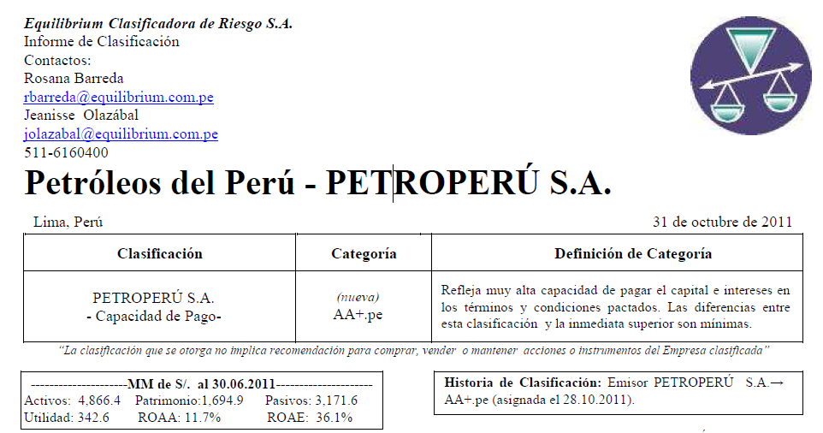
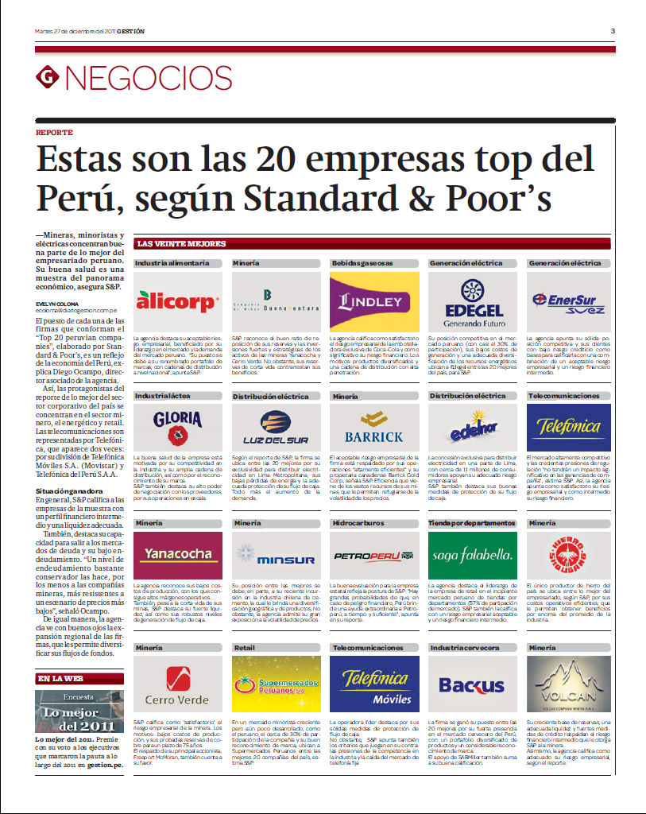


Honors
Medalla Empresa Líder en Calidad – Categoría de Plata
Sociedad Nacional de Industrias – Oct 2011

Slide 9
Best corporate governance
In 2006, the Good Corporate Governance (GCG) Draft Code of PETROPERÚ S.A.
In 2008, the PETROPERÚ participation in the “CAF” program of “DIAGNOSIS AND IMPLEMENTATION IN CORPORATE GOVERNANCE” for state – owned companies.
In 2009, the GCG committee was approved by the board of directors.
In 2010, the GCG internal regulations (PENDING APPOINTMENT OF PARTICIPANTS), was approved by the board of directors.
In 2010, Board of Directors approved BCG with 27 principles: REGULATORY FRAMEWORK; STATE AS OWNER, PROPERTY RIGHTS; EQUITABLE TREATMENT WITH THE STOCKHOLDERS; RETIONSHIPS WITH STAKEHOLDER GROUP; TRANSPARENCY; AND MANAGEMENT AND BOARD OF DIRECTORS.
In 2011, the GCG Internal assessment.
In 2012, Coordination with BID for training workshops in GCG.
In 2012, adherence to EITI initiatives.
In 2012, Lima Stock Exchange acknowledgment.

Slide 10
1. PROJECTS OF PETROPERÚ

Slide 11
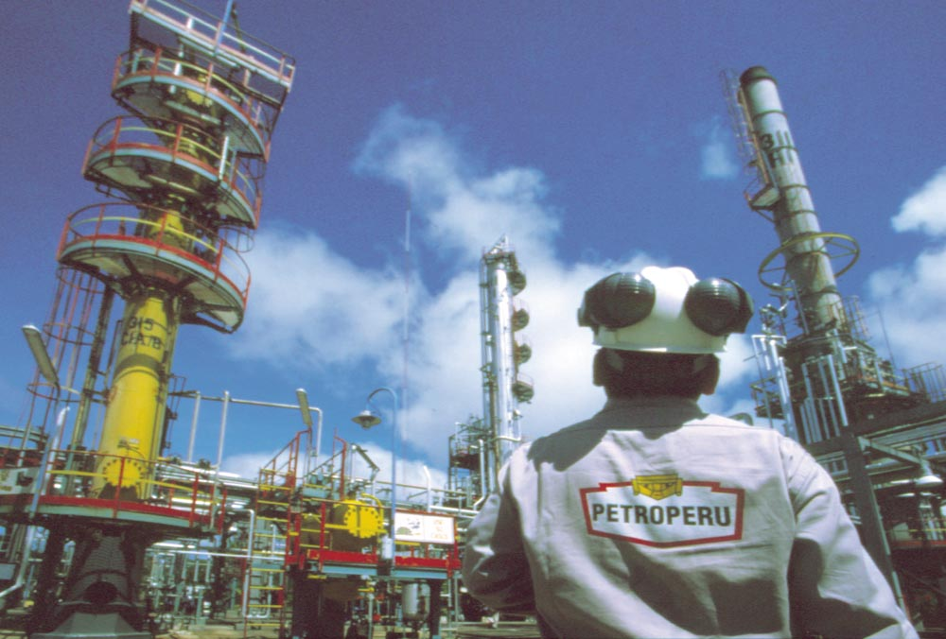
The Talara refinery modernization project
Producing less polluting fuels (50ppm)
Generating its own electric power to Refinery
Processing heavier crudes
Increasing capacity from 65,000 to 95,000 barrels per day
Improving performance of light fuels
Including new units
The Talara refinery modernization Project includes the expansion and modernization of existing units and equipment of new units.
Estimate amount on March 2011:
US$ 1,700 million (Cost class 4)
Projected financing schedule:
Debt 80% (Loan)
Own contribution 20%
Mechanical Completion Date: December 2015

Slide 12
Cost estimate classification
CLASS | Project definition | Purpose of estimate | Estimating method | Accuracy range | Preparation effort
Class 5 | 0% to 2% | Conceptual | Capacity factored, Parametric models, Judgement or analogy | L: -20% to -50% H: +30% to +100% | 1
Class 4 | 1% to 15% | Studies of Feasibility | Equipment factored or parametric models | L: -15% to -30% H: +20% to +50% | 2 to 4
Class 3 | 10% to 40% | Budget, Authorization, or Control | Semi-detailed unit costs with assembly level lines | L: -10% to -20% H: +10% to +30% | 3 to 10
Class 2 | 30% to 70% | Control or Bid/ Tender | Detailed unit cost with forced take-off | L: -5% to -15% H: +5% to +20% | 4 to 20
Class 1 | 50% to 100% | Check Estimate or Bid/Tender | Detailed unit cost with detailed take-off | L: -3% to -10% H: +3% to +15% | 5 to 100

Slide 13
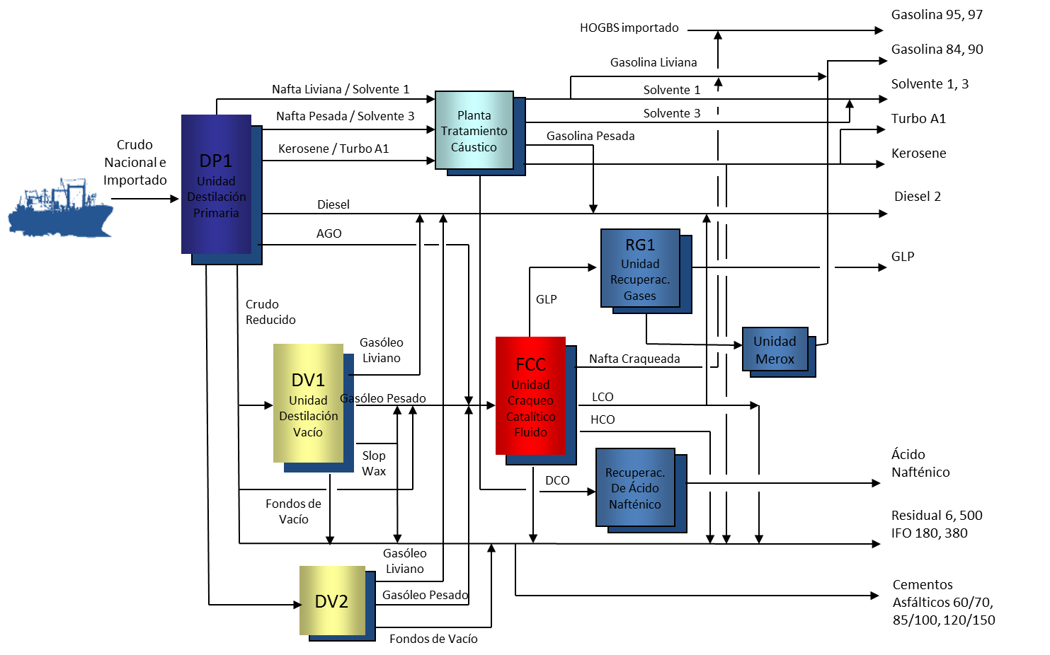
Refinery current scheme

Slide 14
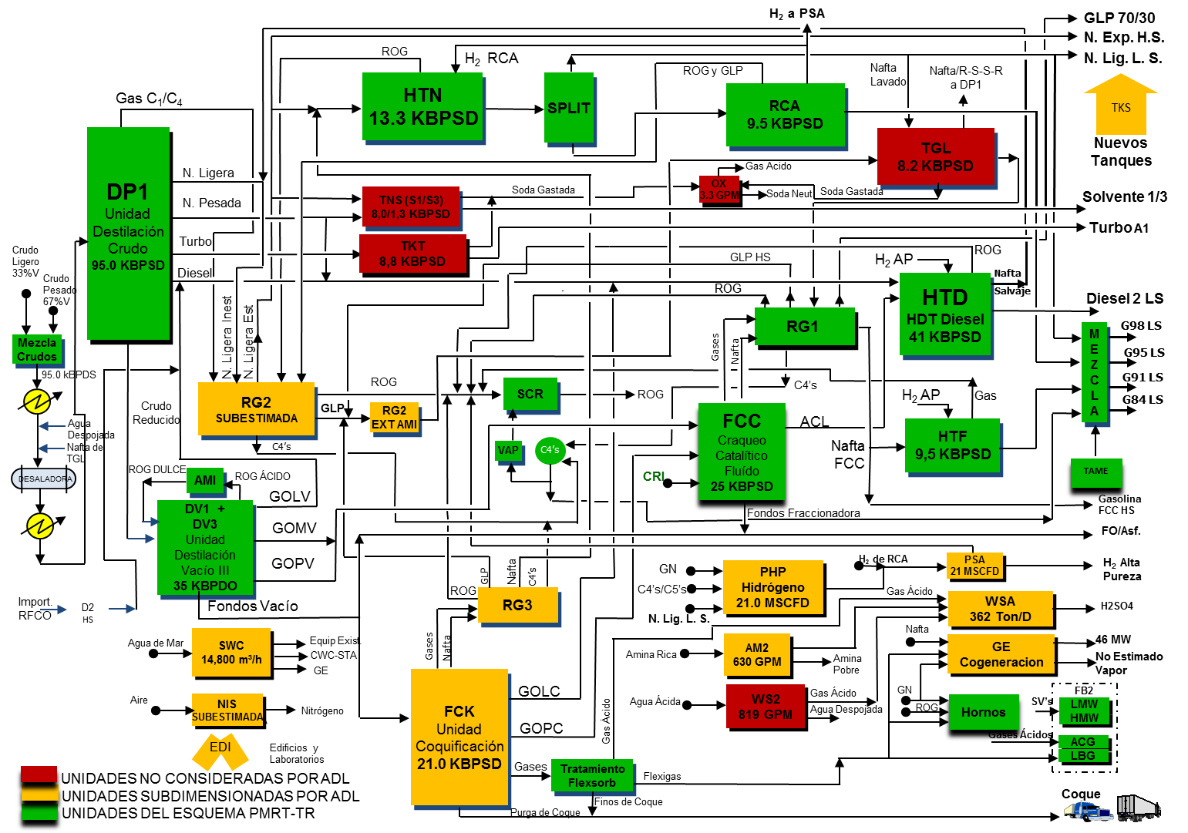
Talara refinery modernization scheme
(changes regarding ADL – 2006 on green and orange)
Notes:
14

Slide 15
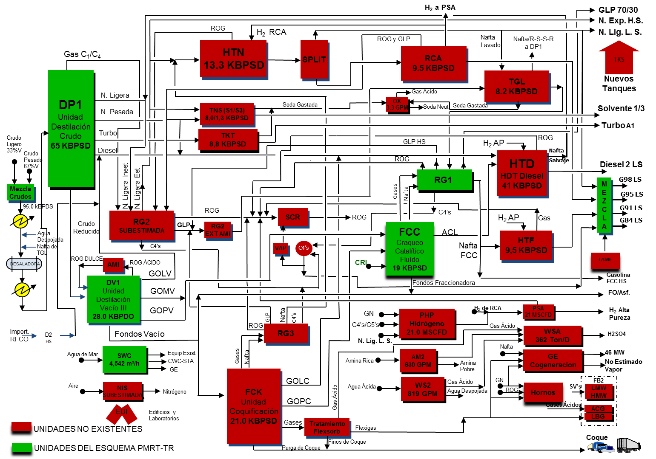
Talara refinery modernization scheme
(Refinery current scheme on green)
Notes:
15

Slide 16
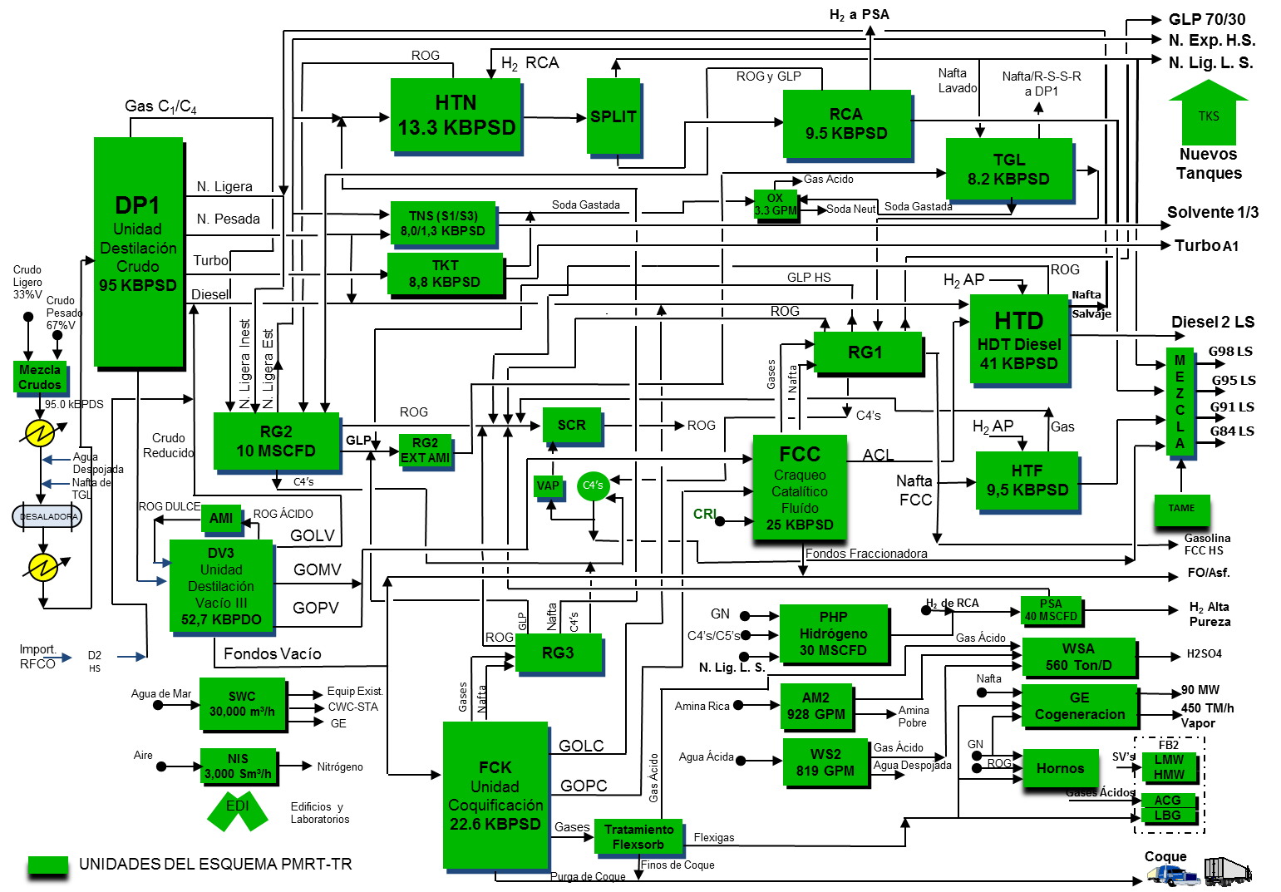
The last refinery scheme

Slide 17
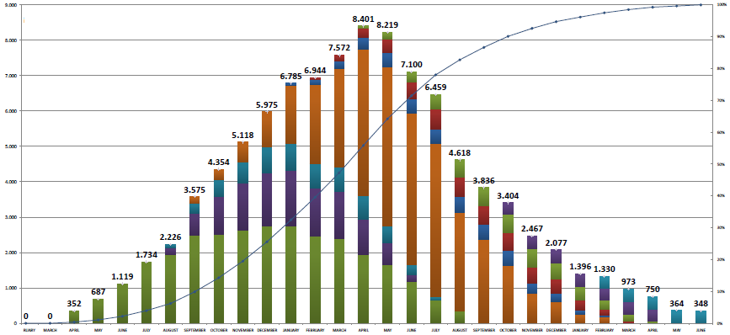
Impacts of Modernization Project
Direct personnel who will participate in the project. Peak between 8000 and 9000 people.
Source: Técnicas Reunidas

Slide 18
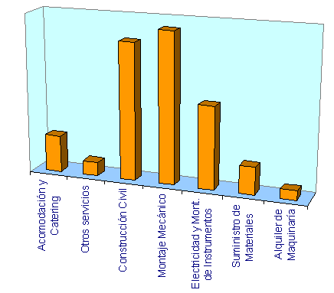
Impacts of Modernization Project
60% of total investment will be hired with Peruvian companies
Accomodation and catering
Mechanical assembly
Other services
Material supply
Civil construction
Machinery rent
Electricity and instrument assembly

Slide 19
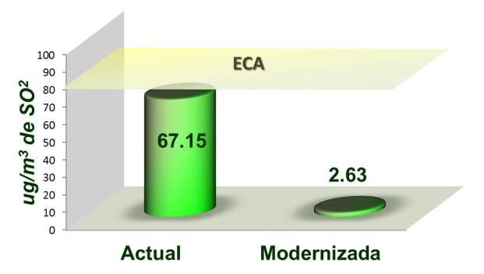
Impacts of Modernization Project
The new refinery will produce diesel of only 50 ppm sulfur (instead of 1,800 ppm at present), which will decrease the respiratory diseases that occur when the sulfur is inhaled.
Air Quality :
of
Updated
Legend:
ECA: Estándar de Calidad de Aire (Air Quality Standard)
Ug/m3: Micrograms per cubic meter
S02: Sulfur Dioxide

Slide 20
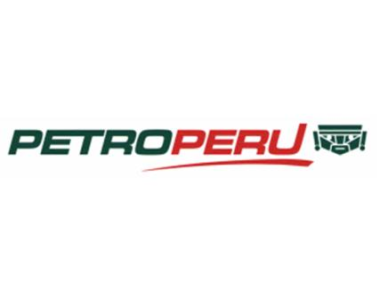
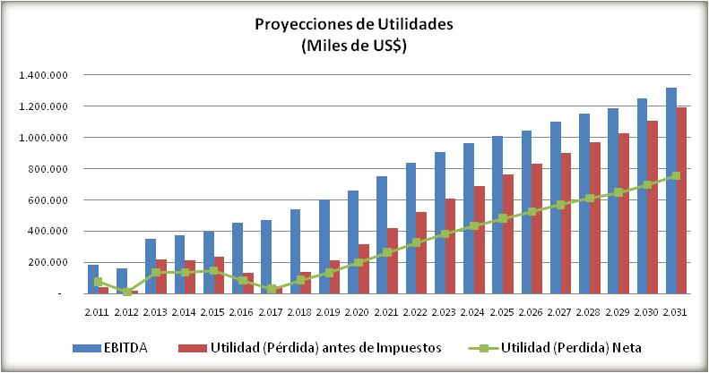
Petroperú is available to pay
Projected profits
(Thousand of US$)
Pre-tax Profit (Loss)
Net Profit (Loss)
Source: COFIDE. Informe Financiero Detallado. 2011

Slide 21
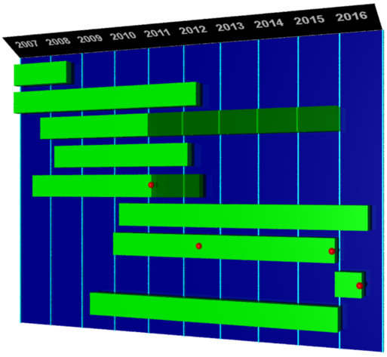
Schedule
Approval of
EIA
Feasibility study
Advising
Social administration
Technologies
Environmental Impact Assessment
Financing
PMC
Mechanic completion
FEED-EPC
Test and Start-up
Start of operation
HR
Estimated Investment amount / Class 2
(July 2012)

Slide 22
Return to Upstream (Access to production)
In the next years, oil lots with contracts that will finish will start to reverse to the Peruvian State. There is a state policy that Petroperú will participate again in the production phase associated with investors. Perupetro is designing the policy allowing joint participation of Petroperú.
Year | 2013 | 2014 | 2015 | 2016 | 2017 | 2018 | 2019 | 2020 | 2021 | 2022 | 2023 | 2024 | 2025
 | Lot II (INTEROIL)
 | Lot IV (INTEROIL)
 |  |  | Lot VII / VI (SAPET)
 |  |  | Lot 1 – AB (PLUSPETROL NORTE)
 |  |  |  | Lot II (PETROLERA MONTERRICO)
 |  |  |  |  |  |  |  |  |  | Lot I (GMP)
 |  |  |  |  |  |  |  |  |  | Lot V (GMP)
 |  |  |  |  |  |  |  |  |  |  |  | Lot Z – 2B (SAVIA)
 |  |  |  |  |  |  |  |  |  |  |  | Lot X (PETROBRAS)
 |  |  |  |  |  |  |  |  |  |  |  |  | Lot 8 (PLUSPETROL)
LOTS | 2 | 2 | 4 | 5 | 5 | 5 | 5 | 5 | 5 | 7 | 7 | 9 | 10
Lots in the northwestern
Lots in the north and central forest

Slide 23
PETROPERÚ S.A.’s proposal
It is necessary to articulate a State Policy regarding the governmental decision of PETROPERÚ return to Upstream. This policy has to be conducted in permanent coordination with MINEM and PETROPERÚ.
The PETROPERÚ modality return to «upstream» should be assessed on a case- by-case basis, as geological conditions, production volume and contractual arrangements are different in each agreement.

Slide 24
2. The south andean gas pipeline

Slide 25
MAIN RESULTS
Impact around to 1% of GDP.
It will generate 40,000 new employments approximately.
Increase the country energetic security.
Origin of the first petrochemical pole in the country.
It will allow the development of other industries.
Mainly, it will give access to south the cheapest and cleanest energy, carrying nature gas to important cities in the south of the country (Cusco, Juliaca, Arequipa, Ilo, Quillabamba, Matarani, Moquegua).
“It is a Project that will change not only the life of Cusco, but also of the country and particularly in the south.”
Press Conference in Quillabamba
PRESIDENT OLLANTA HUMALA
03.29.2012

Slide 26
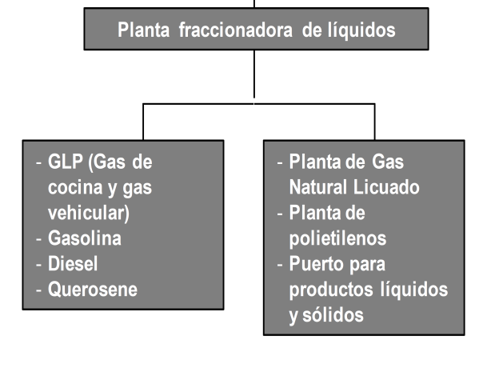
THE GAS PIPELINE COMPRISES OF A MAJOR PROJECT
Extraction and Production: Forest
Transport: from forest to coast
Distribution
Petrochemical Pole

Slide 27
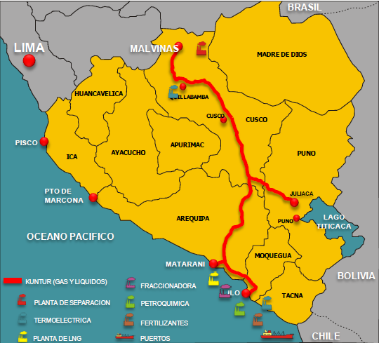
THE SOUTH ANDEAN GAS PIPELINE
Gas pipeline of 1085 km which will transport natural gas from Camisea (in the Cusco Region) to Puno, Arequipa and Moquegua Departments.
The construction of two thermoelectrical power plants and energy node (Quillabamba, ILO and Energy Node) are being considered.
The development of petrochemical industrial hub.

Slide 28
Energetic Security
The first tranche which goes to Quillabamba will allow to give the energetic security that the national system requires, due to the power generation depends on single pipeline at present.

Slide 29
The petrochemical hub
Ethane can be transformed into important materials for manufacturing industry (polyethylene), generating a significant impact in sectors such as agriculture, construction, automotive industry, textiles, plastics, etc.
VALUE CHAIN GENERATED BY ETHANE

Slide 30
3. The Peruvian state’S participation

Slide 31
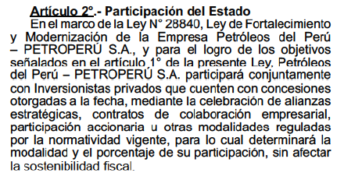
The PETROPERÚ S.A.’s participation in the south gas pipeline
The Law No. 29817 sets forth that Petroperú will participate in this project. The percentage of shareholders has not yet be determined.
Objective
Security of the energy market
Natural gas overcrowding to south
Power generation decentralized
Total amount: To be defined after Due Diligence

Slide 32
The feasibility of PETROPERÚ S.A.’s participation and Agreement with the CAF
In February 2012, a Technological Cooperation Agreement was undersigned between CAF and PETROPERÚ S.A. to provide technical and financial support for PETROPERÚ participation in the Project.
Within the framework of said Agreement, CAF determined with the PETROPERÚ approval that the Echecopar firm will provide legal support. In addition, the subsidiarity report was drafted.
GULF Interstate Engineering Perú S.A.C. will provide technical support for the estimated investment amount in the pipeline. The final report was submitted in the first fortnight of June.
The General Bureau of Hydrocarbons of MEM has approved the modification of the Transport regulation
Negotiations with KUNTUR are in process to define the final scheme of the project and the participation of PETROPERÚ.

Slide 33

Echecopar Firm Report
«…It is clear that the Peruvian Congress has motivated the Petroperu’s involvement in the construction and operation involved in the Project of Transport System for Hydrocarbons derived from natural gas through the Camisea pipeline granting the adequate legal coverage required by the Section 60 of the Constitution».
In addition, PETROPERÚ S.A. «is fully approved by the Peruvian Congress» to participate in the project.
Subsidiarity Report – Echecopar Firm

Slide 34
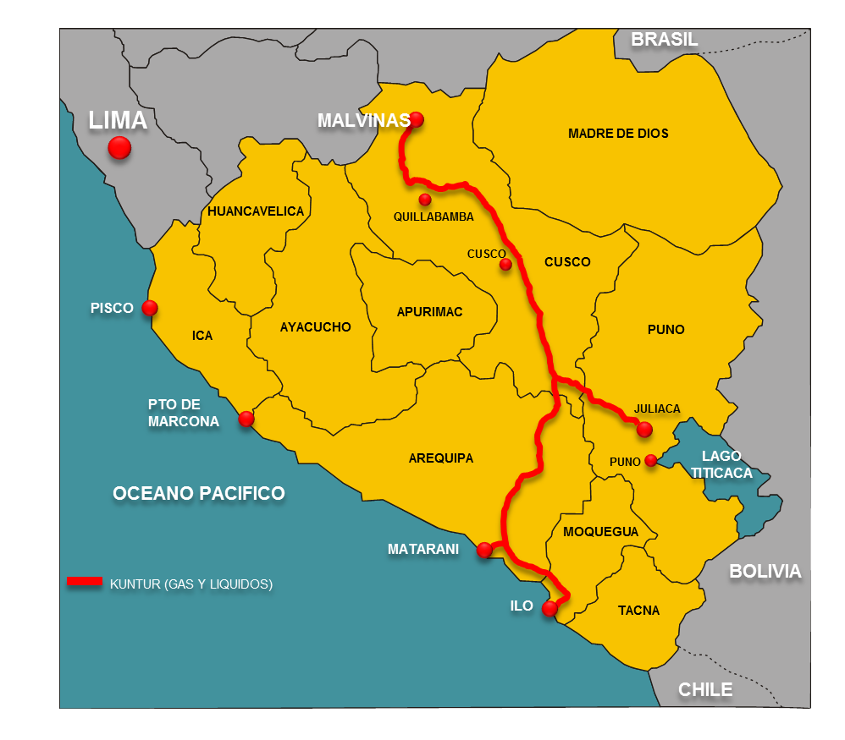

Previous project : LNG to the South
The Agreement of intention was signed with Repsol to assess the project of carrying liquefied natural gas (LNG) from Pampa Melchorita to the main cities of the south of the country, through the Pipeline Virtual System. The study is feasible.
Total Amount: US$ 105 millions, to be invested from 2012 to 2015.
Petroperu’s Estimated Participation: US$ 51 millions
Startup of Operations: December 2012.
MADRE DE DIOS
CUSCO
CUSCO
Cargadero
Perú LNG
ICA
AYACUCHO
APURIMAC
PUNO
JULIACA
AREQUIPA
PUNO
MOQUEGUA
TACNA

Slide 35
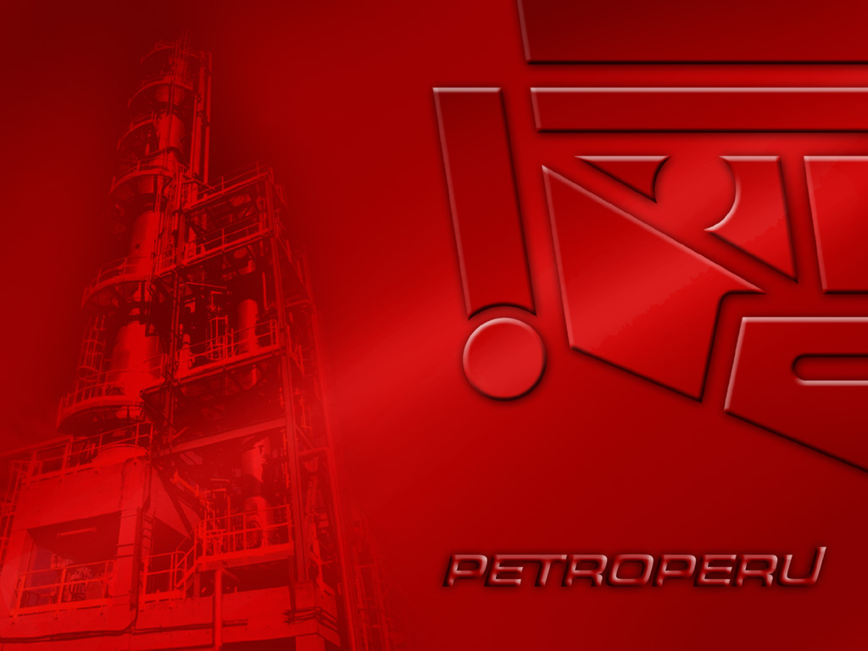
THANK YOU

