Slide 1
Energy day
July 3th, 2012

Slide 2
TABLE OF CONTENTS
Enersur
    Active projects
    Unique position
Issues of the electric sector
    Issue of the electric sector
    Supply-demand balance
    Portfolio of generation
    Gas issue of the electric sector

Slide 3
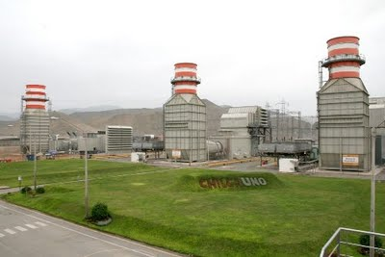

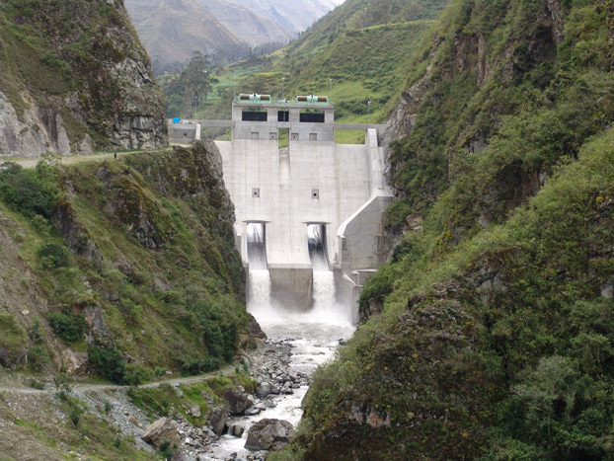
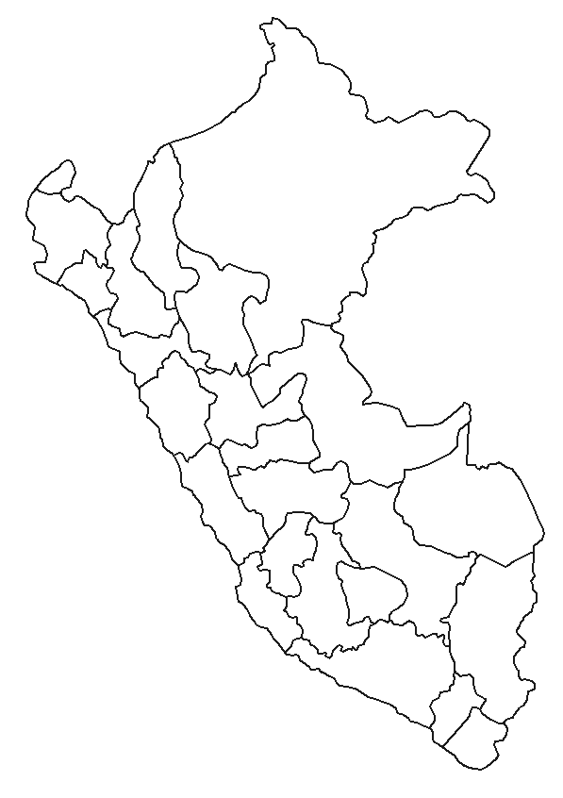
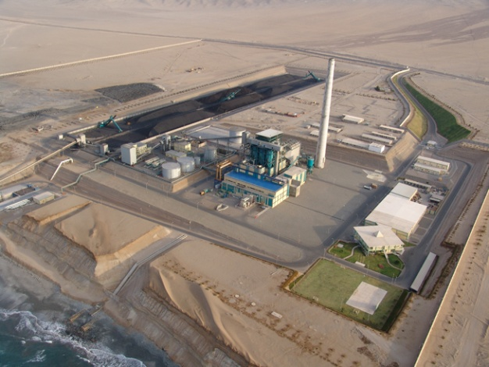
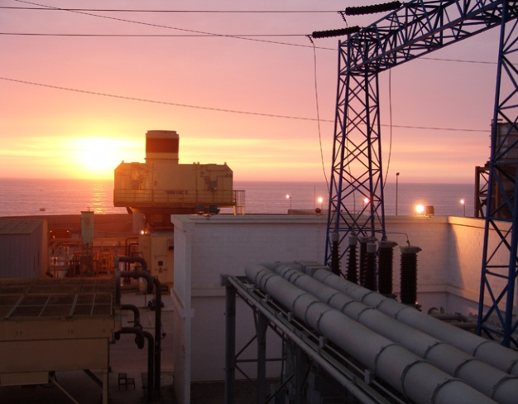
Enersur: Active projects
C.H. Quitaracsa Project:
Additional 112MW
COD 4Q 2014
C.T. ChilcaUno (Natural Gas)
560MW
Combined Cycle Project:
Additional 270MW
COD 1Q 2013
C.H. Yuncán (Hydraulic)
130MW
C.T. Ilo 21 (Coal)
135MW
C.T. ILO 1 (Diesel, R500 and steam)
261MW
Cold reserve Project:
Additional 460MW
COD 3Q 2013
MW: Nominal Capacity

Slide 4
Enersur: Unique position
AT OPERATIONAL LEVEL
In 2001, operation of the unique coal-fired thermal power plant of Peru, the C.T. ILO21
In 2004, concession of Yuncán, under the Usufruct contract for 30 years
In 2005, the C.T. ChilcaUno is the first completely new natural gas-fired power plant in the country using Camisea gas.
In 2010, Yuncán is the unique hydropower plant operating in remote mode (from Lima)
AT FINANCE LEVEL
In 2004, 1st Private Equity made in Peru by the AFP’s was in EnerSur;
In 2005, EnerSur lists its shares in BVL and sells approx. 17% of its capital. It was the first OPV of shares in BVL in more than 8 years;
In 2007, organization of a corporate bonus program for up to US$ 400 millions without real guarantees, with a rating of AAA (the largest emitter among the power plants in Peru with a balance of US$ 160 millions);
In 2010, a greater Corporative Leasing in Peru, US$ 310 millions to finance the Combined cycle of ChilcaUno;
In 2011, first Leasing Corporate subordinate in Peru, US$ 200 millions, to finance the Cold Reserve of ILO
In 2012, US$ 150 millions of capital increase through preferential subscription with 99.4% of participation only in 1st round.
CONCLUSIONS
Unique generator company in the country with 5 different energy sources (hydraulic, natural gas, carbon, residual 500 and diesel)
Unique generator company with 3 projects in implementation that will double its generation capacity between 2010 and 2014.
Unique generator company listed on stock market that has had access to the capital market

Slide 5
TABLE OF CONTENTS
Enersur
    Active projects
    Unique position
Issues of the electric sector
    Issue of the electric sector
    Supply-demand balance
    Portfolio of generation
    Gas issue of the electric sector

Slide 6

Issue of the electric sector
What is it looking for?
How can it be achieved?
    Energy Matrix with Diversification
      Localization
      Source
      Size
Reduced Social and Environmental Impact
Maximum supply security
Lower cost

Slide 7
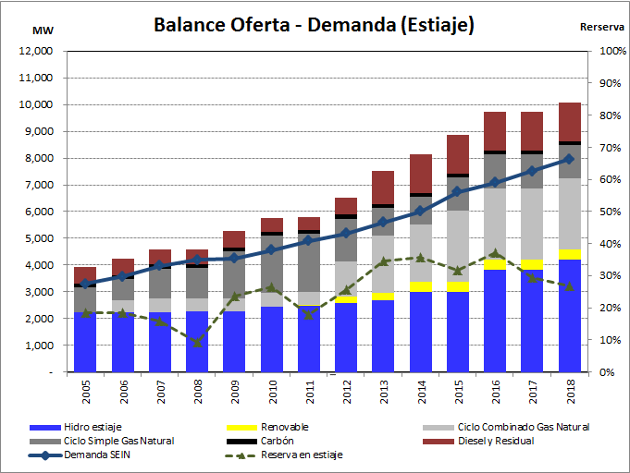
Issue of the electric sector
Supply-demand Balance
SUPPLY-DEMAND BALANCE (LOW WATER)
Source: 2005-2011 COES
2012-2018 ENERSUR
Notes:
A strong and continued economic growth implies a strong growth in energy consumption. GDP 8% in 2011; about 6% in the future.
Challenges:
Demand volatility
Supply-demand balance by area.
Dependence on transmission line.
Dependence on gas transport.
Diversification of generation sources.

Slide 8
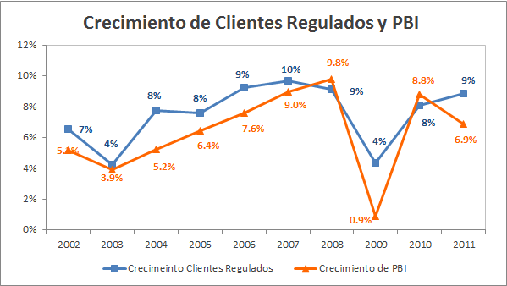
Issue of the electric sector
Supply-demand balance: zonal imbalance
Economic growth and electric demand:
Growth of regulated customers and GDP
Source: OSINERGMIN / INEI
Projects / Extensions | 2012 | 2013 | 2014 | 2015 | 2016 | 2017 | 2018
In terms of Power (MW)
Total North area | 20 | 20 | 44 | 44 | 44 | 69 | 184
Total Central area | - | 90 | 216 | 246 | 341 | 446 | 561
Total South area | 70 | 97 | 272 | 727 | 872 | 932 | 932
Source: ENERSUR
Notes:
The regulated demand, final users and small industrial customers, in 2010 have increased due to greater dynamism in the economy.
It is estimated that this growth will continue in the following years.
Mining projects entering in the following years will increase the total energy demand of SEIN.

Slide 9
Issue of the electric sector
Supply-demand balance: zonal imbalance
Total December 2011:
Demand: 4,961MW
Efficient supply: 5,866 MW
Inefficient supply: 550 MW
Reserve: 29%
NORTH
Project: NG Transport to the North?
North
Demand: 794 MW
Efficient supply: 583 MW
Inefficient supply: 140 MW
Reserve: -9%
Camisea - TGP expansion
COD: 01/2015?
TL Zapallal-Chimbote-Trujillo 600MW
COD: 12/2012?
Center
Demand: 3289 MW
Efficient supply: 4715 MW
Inefficient supply: 132 MW
Reserve: 47%
CENTER
Project: Gas to the South: COD?
South
Demand: 878 MW
Efficient supply: 568 MW
Inefficient supply: 278 MW
Reserve: -4%
SOUTH
TL Chilca-Marcona-Montalvo 600MW
COD: 03/2014?
Source: COES
9

Slide 10
Issue of the electric sector
Portfolio of generation
Hydro
  Water access security
    Lack of clear rules to determine the ecological flow for Hydraulic Power Plants
  Hydro power plant price vs. natural gas power plant price
    Hydraulic power plant price tendered through PROINVERSION (2012: US$ 61.4/MWh) and power plant price of combined cycle of LP Tenders is around (2012: US$ 51/MWh)
    Hydro power plant paid by distributors
Gas combined cycle
  → Competitiveness North/ Center/ South and competitiveness with hydro to ensure the generation portfolio balance?
Carbon
  Selective Excise Tax (ISC): The ISC to carbon will be in 2014: US$ 37/Ton; 2015: US$ 41/Ton; and 2016: US$ 45/Ton ($ 15/MWh)
  Removes competitiveness to coal-fired power plants and eliminates technology to provide energy to the country ... without generating taxes because these plants will not deliver with under these conditions
Peaker (Gas or diesel open cycle)
  Price/capacity with FAIG: units only receive approx. 70% of regulated power price
  Gas: Gas ToP without security of delivery. To receive income from power, units must have 100% of firm transportation (COES Procedure No. 25)
  Diesel: security of transportation and refinery capacity?
  Lack of motivation to put cutting-edge units: cold reserve tender is required
RER
  RERs are an expensive generation alternative (especially solar generation), which do not guarantee capacity (except geothermal generation)
  → Socio-environmental solution

Slide 11
Issue of the electric sector
Gas issue of the electric sector
Gas condition
  Price in different areas?
  Level of "Take or Pay" to finance infrastructure (E&P, transport) in different areas?
  → How to ensure competitiveness with hydro and among areas (north, center, south)?
Controllable risk level?
  Lack of symmetry of income structure (capacity at low cost, delivery-based energy) vs. cost structure (high ToP level of molecule and transport)
  Delivery level depends on annually declaration of gas price (with Combined Cycle in competence)
    The declaration system of natural gas artificially reduce the marginal cost of the system
    Risk of paying high ToP level (molecule, transport) without deliver.
  How to ensure the controllable risk level (and therefore investment)?

Slide 12
Thank you

