Slide 1
For a New Sustainable Energy Matrix
Presentation of Dr. Raúl E. García
(NUMES Project Coordinator)
Energy Day
Lima, July 3rd, 2012
1

Slide 2


Preparation of the New Sustainable Energy Matrix and Strategic Environmental Assessment as Planning Tool
For the Ministry of Energy and Mines with the support of the IDB
2011-2012
2

Slide 3
Study Scope
An strategic nature study that allows to choose between different alternative energy plans.
The product is the New Sustainable Energy Matrix (NUMES) for the period 2010-40 and its Strategic Environmental Assessment (EAE).
Main Objectives:
  NUMES designed for the rational use of the energy resources.
  EAE to guarantee the chosen NUMES sustainability.
  Sector Planning Tool and development of tools for the National Energy Plan.

Slide 4
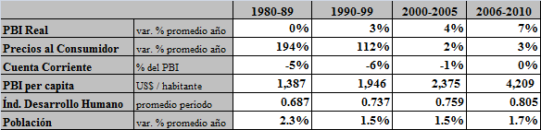
Socio-Economic Context
Economic activity in ascending cycle with a strong investment growth.
Improvement of the trade balance that underpins the balance of the external accounts.
Since 1980, per capita income indicators have almost quadrupled; at the same time, the Human Development Index (HDI) has increased and the poverty level has decreased to half. However:
  The HDI increased but very differently between departments.
  In average, the income distribution improved (Gini Coefficient), but with delays at a regional level.
  Increasing concern for the increase of socio-environmental conflicts.
Real GDP
Year average var. %
Consumer Price
Year average var. %
Current Account
GDP %
GDP per capita
$ / inhabitant
Human Development Index
Period average
Population
Year average var. %

Slide 5
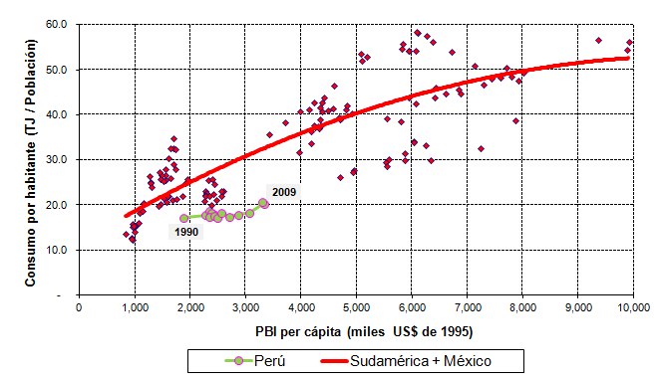
Energy Sector Performance
The energy demand kept the growth tendency vis a vis the economic activity level (30% between 2000 and 2009) and the population income.
The per citizen energy consumption grew, between 1990 and 2009, in 21%, while the GDP per capita (measured in dollars from 1995) grew in 75%.
However, Peru still displays a low per citizen energy consumption in comparison with the Region average level.
Consumption per citizen
GDP per capita (Thousands US$ from 1995)

Slide 6
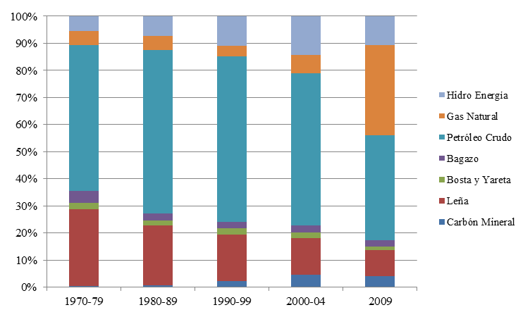
Energy Sector Performance
Change in the energy consumption structure.
In the period 1970 – 1990, the crude oil and the firewood concentrated the 80% of the Primary Energy Domestic Gross Supply (OIBEP).
Subsequently, gas increased its participation.
To the present, oil represents 39% of the OIBEP, gas and gas liquids a 33%, hydropower an 11% and the remaining 17% is biomass, carbon and solar.
Hydropower
Natural Gas
Crude Oil
Bagasse
Dung and yareta
Wood
Mineral Coal

Slide 7
III. Methodology for the NUMES Selection

Slide 8
Phases
The following phases were met:
Diagnosis of the energy sector and SWOT analysis by sources
Selection of Futures from uncertainties valuation
Plan Definition from energy policy options
Preparation of an Environmental Energy Model to project the energy national balance.
Attributes determination to measure the results
Selection of Strong Plans
Design of the NUMES Plan and assessment of its results
Socio-environmental Assessment
Scenarios
    MINMAX
    Trade Off Analysis
    Socio-environmental Model

Slide 9
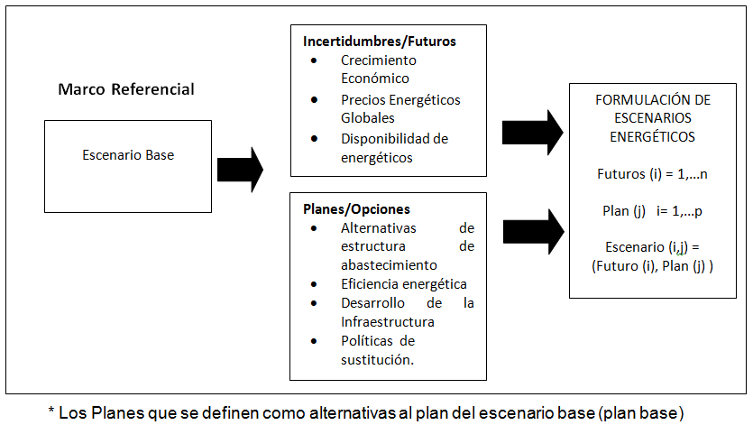
Scenarios Formulation
Uncertainties/Futures
Economic Growth
Global Energy Prices
Energy Supplies availability
Referential Framework
ENERGY SCENARIOS FORMULATION
Futures (i) = 1,…n
Plan (j) = 1,…p
Scenarios (i,j) =
(Future (i), Plan (j))
Base Scenario
Plans/Options
Supply Structure alternatives
Energy efficiency
Infrastructure Development
Substitution Policy.
Uncertainties/Futures: variables out of control of the planner whose combination represent a Future.
Options/Plans: an specific set of setting options of the Energy Sector determine a Plan.
Scenario: a combination of a plan j and a future i

Slide 10
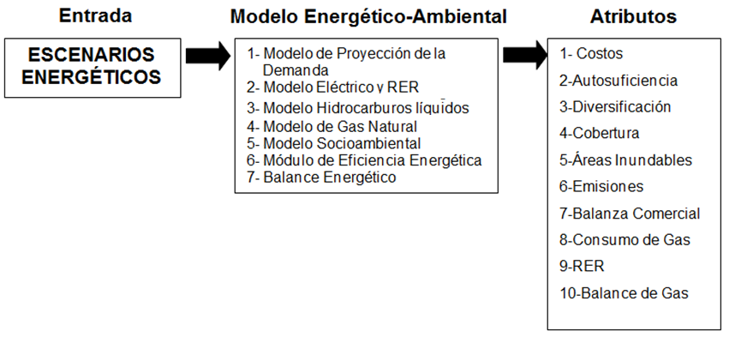
Scenarios Assessment: Environmental Energy Model and Attributes
Entry
Environmental-Energy Model
Attributes
ENERGY SCENARIOS
1- Projection of the Demand Model
2- Electric Model and RER
3- Liquid Hydrocarbon Model
4- Natural Gas Model
5- Socio-environmental Model
6- Energy Efficiency Module
7- Energy Balance
1- Costs
2- self-sufficiency
3- Diversification
4- Coverage
5- Flooding Areas
6- Emissions
7- Trade Balance
8- Gas Consumption
9- RER
10- Gas Balance
Notes:
Electric Model and RER, Liquid Hydrocarbons Model, Natural Gas Model: Include demand/supply , transformation processes, simulations and energy resources use.

Slide 11
NUMES Determination Process
OBJECTIVE
NUMES Validation
Results
Method
MINMAX
and
OBJECTIVE
:
SCENARIOS
:
Trade Off Analysis
NUMES
For the selection
Strong
Objective
•
MINMAX
Attributes
of
Plans
•
Trade Off Analysis
each
Plan
in
(Proposed
•
EAE
each
F
Interdisciplinary analysis
Plan)
•
Disasters
uture
And
EAE of
results
analysis
•
Sector Analysis
Escenario (i,j)
Process
Iterative
Phase I
–
Selection
Strong Plans
Phase II
–
NUMES
Objective

Slide 12
Strong Plans Selection Methodology and NUMES
MINMAX:
  It is to compare how each plan behaves in the worst possible future context and to choose the plan that better «resists» in face of adversity.
  The optimal plan can change depending on the attribute considered, which generates objectives conflict (Trade off).
Trade Off Analysis:
  It is a comparison between plans, in pairs, to determine if a plan dominates another and by this delimit the set of eligible plans.
  The plans not dominated in a certain future are part of the selection set.
  The plans within the choice set for all the futures are considered strong.

Slide 13
NUMES Plan
Several plans turned out to be strong; however, they had certain opposite features: electricity supply structure, development or not of the petrochemistry in the South and of the heavy crudes.
It was possible to build a strong plan of better performance in a greater amount of attributes from the combination of the best options of the different strong plans with the purpose of proposing the NUMES objective.
Option
Features
Electricity Supply Structure
Hydroelectric power40%, Natural Gas 40%, RER 20%
Petrochemistry
In Ica and in the South
Gas Transportation
South and North Pipelines
Export
PERU LNG and EE exports (Regional)
Oil
Heavy crudes development
Biofuels
5% biodiesel, 10% ethanol
Gas Coverage
Maximum coverage Plan
Energy Efficiency
15%

Slide 14
Socio-Environmental Assessment of Strong Plans
Multi-criteria Analysis (AMC)
Geographical Information Systems (SIG)
Definition of Social and Environmental Indicators
Environmental, Social and Energy Information
Multi-criteria Analysis
(Definite 3.1)
Results
MINMAX Assessment– Strong Plans
Strong Plans Social and Environmental Performance
14
Notes:
14
14

Slide 15
NUMES: Projection of the Demand at Final Use Level by Sectors
2009
2040
RESIDENTIAL AND
INDUSTRIAL
INDUSTRIAL
COMMERCIAL
18.51%
22.09%
27.63%
RESIDENTIAL AND
COMMERCIAL
26.52%
MINING
MINING
METALLURGIC
METALLURGIC
12.13%
8.70%
FISHING
FISHING
1.84%
0.74%
PUBLIC
PUBLIC
1.82%
TRANSPORT
0.84%
TRANSPORT
AGRICULTURAL AND
36.92%
AGRICULTURAL AND
40.10%
AGROINDUSTRY
AGROINDUSTRY
1.41%
0.75%

Slide 16
Final Consumption Structure by Sources by 2040
Natural Gas
Oil
Derivatives
38%
38%
Hydro + Renewable
21%
Others
3%

Slide 17
Cumulative Investment by 2040
Activity
Billions US$
NATURAL GAS
27,5
Exploration - Production
14,3
Transport
4,9
Distribution
1,4
Use (NGV and Petrochemistry)
7,0
LIQUID HYDROCARBON
26,9
Exploration - Production
17,4
Processing and Distribution
8,5
Biofuels
1,0
ELECTRICITY
29,0
Generation (includes RER)
24,5
Transmission and Distribution
4,5
TOTAL
83,4

Slide 18
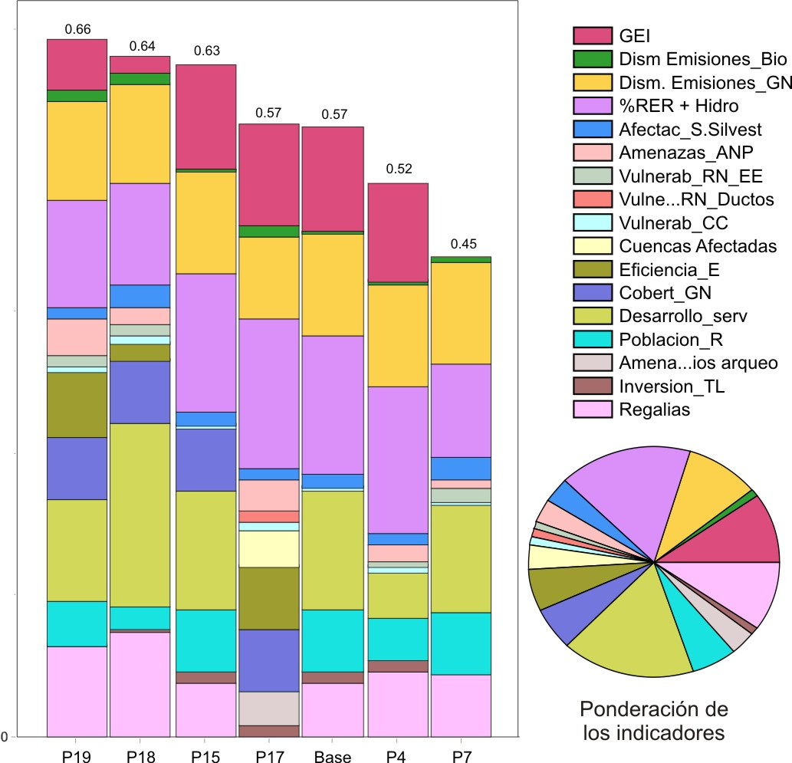
Results of the Proposed Strong Plans Assessment
Weighting Indicators
Notes:
18

Slide 19
NUMES Plan Guidelines
The Energy Plan must be part of a State Policy for the sustainable development.
The plan involves a review of the State role. This implies greater proactivity and adaptation of the entrepreneur role through the activity developed by its energy companies.
The planning task of sector must be complemented with the private sector investment role. The uncertainties and the cost of capital are reduced to facilitate investments. Referential Programs (not mandatory) and Plans (mandatory).
Prices formation policy and fees of the energy must encourage the resources development and promote the economy competitiveness with better standards of energy efficiency.
Facilitate the access to energy for low income social sectors.
Diversification of the energy matrix.
Decentralization and regional development.
EAE of the Energy Plan to limit the socio-environmental conflicts and to minimize the environmental impacts.

Slide 20
Implementation – NUMES
Stages
Trunk and «virtual» gas pipelines
Hydroelectric power stations with advanced projects
First projects and RER potential studies
Expansion of energy coverage
Basic petrochemistry
Energy Efficiency Plan Implementation
Gas - generalization outside of Lima
Secondary and tertiary petrochemical development
New hydroelectric power stations
RER project progress
Expansion of energy coverage
Energy Efficiency Projects Progress
Energy integration
Less gas and less oil derivatives
More hydroelectricity
More RER development
Energy Efficiency Projects Progress
Consolidate energy integration
2012 - 2020
2020 - 2030
2030 - 2040

Slide 21
Conclusions and Recommendations
A NUMES has been prepared and proposed from an integrated analysis that considers the interfaces between the energy sub-sectors and the final requests. It is the first long term strategic planning effort performed in the country with an integrated approach, considering the socio-environmental implications relevant for the energy sector.
The NUMES Plan is framed within the objectives of energy policy and socio-environmental sustainability based on a planning supported in a State policy over time.
For the NUMES election, there has been an objective assessment of the different setting alternatives of the energy system, plans for the main uncertainties that face the energy policy makers.
The environmental energy model used in this study is presented as a useful tool to face a long term planning (it allows comparing the costs and other attributes of different decisions to reach policy objectives).

Slide 22
Conclusiones y Recomendaciones
The proposed NUMES Plan will allow: a diversified sources structure with an estimated investment level of US$ 83,439 millions in current value.
The Plan is not static, it is a guide of policy actions in a chosen path, and the tools used in this study allow the MEM its adjustment in time.
The meetings and workshops with the different actors of the sector and of the civil society have enriched this Study.
Considerations have been proposed for the regulatory framework adaptation that identify institutional and organizational aspects of the energy sector that must be modified on the effort to implement the NUMES Plan.
In this regard, it is recommended to assess the creation of a body with autonomy, enough functions and capacities for the Plan implementation, reaching the planned Policy objectives.

Slide 23
THANK YOU FOR YOUR ATTENTION
23

